Slide 1
Translation

Slide 2
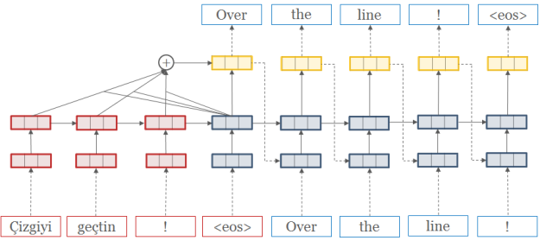
Practice 1
Title : Learning Phrase Representations Using RNN Encoder-Decoder for Statistical Machine Translation
Neural Machine Translation
RNN Encoder Decoder 구조 + Attention
Data Set
Vietnamese to English

Slide 3
Practice 1: Neural Machine Translation
Preprocessing
Character to index (Vietnamese, English 2가지)
Word to index (Vietnamese, English 2가지)
def read_vocab(self, name="vocab.en", mode="enc"): with open(self.path + "/" + name, encoding='UTF-8' ) as fin: lines = fin.readlines() w2idx = {self.unk_token: self.unk_idx, self.stt_token: self.stt_idx, self.eos_token: self.eos_idx} for i, line in enumerate(lines): if (mode=="enc" and i==self.max_enc_vocab) or (mode=="dec" and i==self.max_dec_vocab): break word = line.rstrip() if word not in w2idx: w2idx[word] = len(w2idx) return w2idx
for word in self.w2idx_enc: self.idx2w_enc[self.w2idx_enc[word]] = word for word in self.w2idx_dec: self.idx2w_dec[self.w2idx_dec[word]] = word

Slide 4
Practice 1: Neural Machine Translation
Preprocessing
Read Data File
def read_file(self, name=“train"): with open(self.path + "/" + name + ".vi", encoding='UTF-8') as fin: enc = fin.readlines() with open(self.path + "/" + name + ".en", encoding='UTF-8') as fin: dec = fin.readlines() for line in enc: words = line.rstrip().split(" ") enc_len = len(words) self.enc_len = min(enc_len, self.enc_len) for line in dec: words = line.split(" ") dec_len = len(words) self.dec_len = min(dec_len, self.dec_len) if len(enc) != len(dec): print(" Size error: {} ! ".format(name)) return enc, dec, len(enc)

Slide 5
Practice 1: Neural Machine Translation
Preprocessing
Load Vocab Dictionary and Train Data
self.w2idx_enc = self.read_vocab("vocab.vi", "enc") self.w2idx_dec = self.read_vocab("vocab.en", "dec") # Train enc, dec, size = self.read_file("train") self.text_enc.extend(enc) self.text_dec.extend(dec) self.train_size += size
# Val enc, dec, size = self.read_file("tst2012") self.text_enc.extend(enc) self.text_dec.extend(dec) self.val_size += size # Test enc, dec, size = self.read_file("tst2013") self.text_enc.extend(enc) self.text_dec.extend(dec) self.test_size += size

Slide 6
Practice 1: Neural Machine Translation
Preprocessing
Data Information
print(' | Size: {}, {}, {}'.format(self.train_size, self.val_size, self.test_size)) print(' | Vocab: {} {}'.format(len(self.w2idx_enc), len(self.w2idx_dec))) print(' | Length: {} {}'.format(self.enc_len, self.dec_len)) print(' | Avg length: {:.1f} / {:.1f} words'.format(self.length.mean(0)[0], self.length.mean(0)[1]))
| Size: 133317, 1553, 1268
| Vocab: 7709 17191
| Length: 60 60
| Avg length: 24.8 / 20.9 words

Slide 7
Practice 1: Neural Machine Translation
Embedding Layer (Model)
Initialize Variable
class Model(object): def __init__(self, emb_dim=128, hidden_dim=128, attn_dim=256, max_enc_len=50, max_dec_len=50, enc_vocab=5000, dec_vocab=5000, stt_idx=1, end_idx=2, use_clip=True, learning_rate=0.001): self.initializer = tf.random_uniform_initializer(-0.1, 0.1) self.emb_dim = emb_dim self.hidden_dim = hidden_dim self.attn_dim = attn_dim self.max_enc_len = max_enc_len self.max_dec_len = max_dec_len self.enc_vocab = enc_vocab self.dec_vocab = dec_vocab self.stt_idx = stt_idx self.end_idx = end_idx

Slide 8
Practice 1: Neural Machine Translation
Setup Layers (Model)
Encoder
Same as Day-2 Practice 1 (Sentence Embedding Model)
Decoder
Add Attention Model

Slide 9
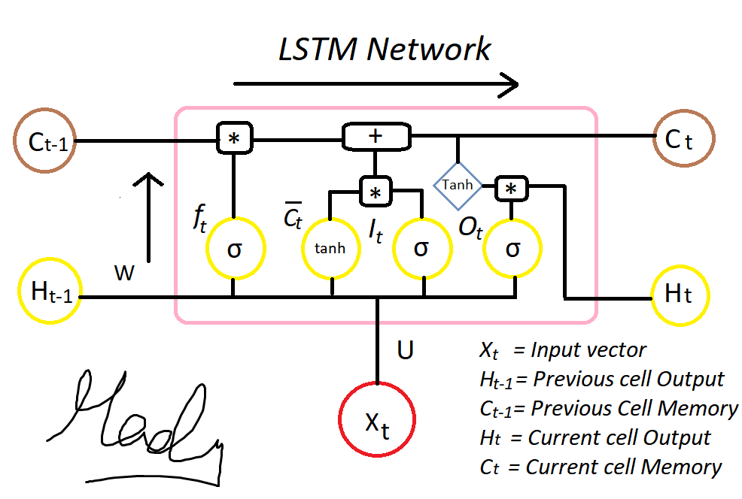
Practice 1: Neural Machine Translation
Setup Layers (Model)
Code
Decoder_init_c
Decoder의 LSTM Cell을 Encoder의 최종 hidden state로 초기화
Decoder_init_h :
Decoder의 LSTM hidden state을 Encoder의 최종 hidden state로 초기화
def rnn_encode(self): # Bi-direction rnn encoder (forward, backward) (self.enc_out, (fw_state, bw_state)) = bidirectional_dynamic_rnn( LSTMCell(self.hidden_dim), LSTMCell(self.hidden_dim), inputs=self.x_emb, sequence_length=self.x_len, dtype=tf.float32) self.enc_out = tf.concat(self.enc_out, 2) # Init for decoder's first state decoder_init_c = Dense(self.hidden_dim, name="decoder_c", activation=tf.nn.tanh, bias_initializer=self.initializer) decoder_init_h = Dense(self.hidden_dim, name="decoder_h", activation=tf.nn.tanh, bias_initializer=self.initializer) self.init_state = LSTMStateTuple(decoder_init_c(tf.concat([fw_state.c, bw_state.c], 1)), decoder_init_h(tf.concat([fw_state.h, bw_state.h], 1)))

Slide 10
Practice 1: Neural Machine Translation
Setup Layers (Model)
Code
def init_enc_attention(self): # self.attn_dim = 300 # defined at init self.attUe = tf.get_variable(name='attnU_et', shape=[1, 1, self.hidden_dim * 2, self.attn_dim], initializer=self.initializer) self.attbe = tf.get_variable(name='attnB_et', shape=[self.attn_dim], initializer=self.initializer) att_e = tf.nn.conv2d(tf.reshape(self.enc_out, [-1, self.max_enc_len, 1, self.hidden_dim * 2]), filter=self.attUe, strides=[1, 1, 1, 1], padding='VALID') self.attUeh = tf.reshape(att_e + self.attbe, [-1, self.attn_dim]) self.attWe = tf.get_variable(name='attnW_et', shape=[1, 1, self.hidden_dim, self.attn_dim], initializer=self.initializer) self.attve = tf.get_variable(name='attnV_et', shape=[self.attn_dim, 1], initializer=self.initializer)
Attention process: softmax(e_t) e_t,i = v^T * tanh (U*h_i + W*s_t + b) --> h_i, s_t 는 각각 encoder / decoder state U*h_i + b 는 encoding 만 완료되면 구할 수 있으므로, 미리 구해주고 decoder state 는 매 디코딩 과정에서 나오는 state를 사용 encoder 각각의 hidden state에 matrix를 개별적을 곱하기 위해 convolution 연산 사용

Slide 11
Practice 1: Neural Machine Translation
Setup Layers (Model)
Code
def encoder_attention(self, state): # decoder state st = tf.reshape(tf.tile(state, [1, self.max_enc_len]), [-1, self.max_enc_len, 1, self.hidden_dim]) attWes = tf.reshape(tf.nn.conv2d(st, filter=self.attWe, strides=[1, 1, 1, 1], padding='SAME'), [-1, self.attn_dim]) # encoder attention distribution e_t = tf.reshape(tf.matmul(tf.nn.tanh(attWes + self.attUeh), self.attve), [self.batch_size, self.max_enc_len]) return tf.nn.softmax(e_t)
Encoder attention softmax decoder state 를 넘겨받아서 attention distribution softmax(e_t) 리턴 tile: encoder 각 state의 e_t,i 구할 때 decoder state 가 필요하므로 encoder 길이(step)만큼 tiling 해줌 tiling 한 뒤 마찬가지로 conv 연산 사용 (W 연산 후 tiling해도 가능할 수 있으나, 직관적으로 위와 똑같이 사용)

Slide 12
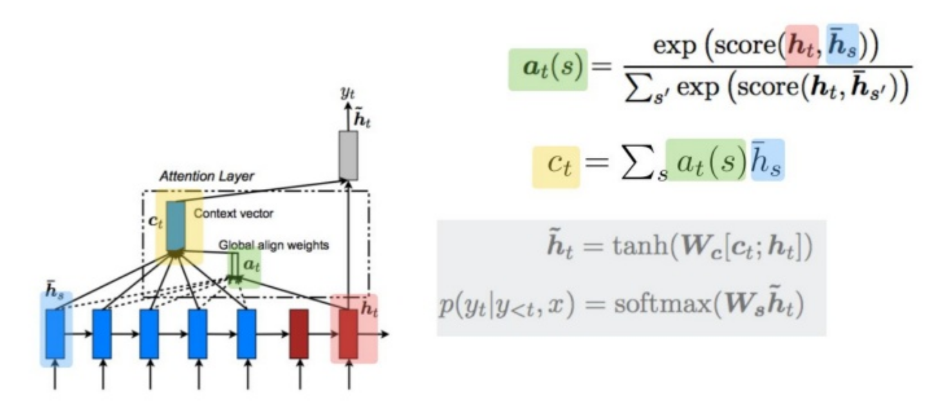
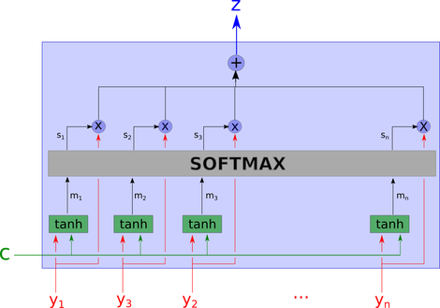
Practice 1: Neural Machine Translation

Slide 13
Practice 1: Neural Machine Translation
Setup Layers (Model)
Decoder Train
Training 과정에서는 Decoder에서 매 Step hidden state에서 계산되는 출력값(Word Probability)를 다음 hidden state의 input으로 사용함
Decoder Infer
Test 과정에서는 Decoder에서 매 Step hidden state에서 계산되는 출력값(생성되는 단어)를 다음 hidden state의 input으로 사용함

Slide 14
Practice 1: Neural Machine Translation
Setup Layers (Model)
Code
def decoder_train(self): # time-batch-dimension y_emb_tbd = tf.transpose(self.y_emb, [1, 0, 2]) word_prob = tf.TensorArray(dtype=tf.float32, size=self.max_dec_len) def body(step, state, word_prob): enc_softmax = self.encoder_attention(state.h) context_vector = tf.reduce_sum(self.enc_out * tf.expand_dims(enc_softmax, -1), axis=1) word_logit = self.out_layer(tf.concat([state.h, context_vector], 1)) word_prob = word_prob.write(step, word_logit) token_emb = y_emb_tbd[step] inp = tf.concat([token_emb, context_vector], 1) next_out, next_state = self.decoder_cell(inp, state) return step + 1, next_state, word_prob _step, _state, _word_prob = tf.while_loop( cond=lambda t, _state, _word_prob: t < self.max_dec_len, body=body, loop_vars=(0, self.init_state, word_prob)) self.train_prob = tf.transpose(_word_prob.stack(), perm=[1, 0, 2])

Slide 15
Practice 1: Neural Machine Translation
Setup Layers (Model)
Code
Tf.while_loop
Lambda: while loop를 언제까지 반복될지 결정
Body: 실행되는 함수
Loop_vars: 초기 변수
_step, _state, _word_prob = tf.while_loop( cond=lambda t, _state, _word_prob: t < self.max_dec_len, body=body, loop_vars=(0, self.init_state, word_prob))

Slide 16
Practice 1: Neural Machine Translation
Setup Layers (Model)
Code
def decoder_infer(self): word_token = tf.TensorArray(dtype=tf.int32, size=self.max_dec_len) def body(step, state, word_token): enc_softmax = self.encoder_attention(state.h) context_vector = tf.reduce_sum(self.enc_out * tf.expand_dims(enc_softmax, -1), axis=1) word_logit = self.out_layer(tf.concat([state.h, context_vector], 1)) next_token = tf.cast(tf.reshape(tf.argmax(word_logit, 1), [self.batch_size]), tf.int32) word_token = word_token.write(step, next_token) token_emb = tf.nn.embedding_lookup(self.emb_W_dec, next_token) inp = tf.concat([token_emb, context_vector], 1) next_out, next_state = self.decoder_cell(inp, state) return step + 1, next_state, word_token
_step, _state, _word_token = tf.while_loop( cond=lambda t, _state, _word_token: t < self.max_dec_len, body=body, loop_vars=(0, self.init_state, word_token)) self.output_token = tf.transpose(_word_token.stack(), perm=[1, 0])

Slide 17
Practice 1: Neural Machine Translation
Setup Layers (Model)
Code
self.rnn_encode() self.init_enc_attention() self.decoder_cell = LSTMCell(self.hidden_dim, state_is_tuple=True) self.out_layer = Dense(self.dec_vocab, name='out_layer') self.decoder_train() self.decoder_infer() self.build_loss() self.build_opt()

Slide 18
Practice 1: Neural Machine Translation
Build Loss
Code
Build Optimizer
Code
def build_loss(self): self.cross_entropy = tf.nn.sparse_softmax_cross_entropy_with_logits(labels=self.y, logits=self.train_prob) self.loss = tf.reduce_sum(self.cross_entropy * self.masks) / (tf.reduce_sum(self.masks) + 1e-10)
def build_opt(self): # define optimizer optimizer = tf.train.AdamOptimizer(learning_rate=self.learning_rate) grad, var = zip(*optimizer.compute_gradients(self.loss))

Slide 19
Practice 1: Neural Machine Translation
Train Model and Result
Code
for it in range(0, 10000): idx, enc, dec, enc_len, dec_len = data.get_batch('train', BATCH_SIZE) loss, _ = sess.run([model.loss, model.update], feed_dict={model.x: enc, model.x_len: enc_len, model.y: dec, model.y_len: dec_len}) avg_loss += loss it_cnt += 1 if it % it_log == 0: print(" it: {:4d} | loss: {:.3f} - {:.2f}s".format(it, avg_loss / it_cnt, time.time() - start_time)) avg_loss, it_cnt = 0, 0 if it % it_test == 0 and it > 0: test_model() if it % it_save == 0 and it > 0: model.save(sess) if it % it_sample == 0 and it > 0: sample_test()

Slide 20
Practice 1: Neural Machine Translation
Result
test loss: 3.192
- true: My story begins when I was in New York City for a speaking engagement , and my wife took this picture of me holding my daughter on her first birthday . We &apos;re on the corner of <unk> and 5th . </s> </s> </s> </s> </s> </s> </s> </s> </s> </s> </s> </s> </s> </s> </s> </s> </s> </s> </s>
--> output: The story begins to the New York in a <unk> , and my wife , I was my <unk> in the first day of her first birthday . We stand in the first time . </s> five . </s> . </s> . </s> . </s> . </s> . </s> . </s> . </s> . </s> . </s> . </s> .
it: 9990 | loss: 3.028 - 2579.09s
test loss: 3.065
- true: We &apos;ve had , like , 50 people come to our <unk> and participate , and it &apos;s all volunteers . </s> </s> </s> </s> </s> </s> </s> </s> </s> </s> </s> </s> </s> </s> </s> </s> </s> </s> </s> </s> </s> </s> </s> </s> </s> </s> </s> </s> </s> </s> </s> </s> </s> </s> </s> </s> </s> </s> </s>
--> output: We have about 50 people to the training , and all the volunteer <unk> . </s> . </s> . </s> . </s> . </s> . </s> . </s> . </s> . </s> . </s> . </s> . </s> . </s> . </s> . </s> . </s> . </s> . </s> . </s> . </s> . </s> . </s> . </s>

